Slide 1
Samsung R&D Vietnam (SRV)
Identity and Access
Management System
Ha Noi, May 25th 2024

Slide 2
Group 18
Member:
Hoang Thanh Lam
Duong Xuan Bach
Mentor:
Vu Trung Quan
Vu Khac Chinh

Slide 3
Assignment Table
Hoang Thanh Lam | Technology Research and Exploration (IAM, OAuth2, OpenID Connect, ... ) Code Front-end (ReactJS) Slide presentation
Duong Xuan Bach | Technology Research and Exploration (OAuth2, OpenID Connect , ... ) Code Back-end (Java Spring Boot) Write documentation

Slide 4
 | Task
1 week | Research, read documentation Planing idea
2 weeks | Design Database Design Web Service Architecture
2 weeks | Setup environment Choose technology
2 weeks | Development and Implementation Testing and Fixing bug
Time
Timeline

Slide 5

Outline
1. Problems
2. Background knowledge
3. Current Solution
4. Implementation and Testing
5. Result Demo

Slide 6



Problems
Overview
Managing and securing user identities and access.
Users have too many accounts and passwords to remember each time they access a website.
Security risk: Without the additional layer of verification provided by 2FA, a user's online accounts are generally less secure.

Slide 7

Web/Web Service
The web relies on a client-server model where web browsers (clients) request information from web servers.
Web services allowing applications to communicate directly, exchanging data using standardized protocols like SOAP or REST APIs.
Background knowledge
Programing
FrontEnd
BackEnd
Database
Authentication, Authorization
Protocols: OAuth2, OpenID Connect, SAML 2.0
Open sources: IdentityServer, Key Kloak, OWASP SSO

Slide 8
Single Sign On
An identity solution that allows multiple applications to use the same authentication session.
Pros:
Simplifies credentials management.
Eases the login process with multiple services.
Cons:
When the SSO provider is down, all applications can be unaccessible.
Stealing SSO credentials give a hacker access to all related systems.
=> Two-factor authentication

Slide 9


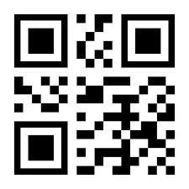

Two-factor authentication
Authentication method required to use two authentication factors to perform authentication.
Authentication factors:
Username and Password
OTP
QR Code
Biometrics
...

Slide 10



Current Solutions
OAuth2
OpenID Connect
Key Kloak
OAuth 2.0 is the industry-standard protocol for authorization. OAuth 2.0 focuses on client developer simplicity while providing specific authorization flows for web applications,
OpenID Connect is an interoperable authentication protocol based on the OAuth 2.0 framework of specifications
Keycloak is an open-source tool that acts as an Identity and Access Management (IAM) server

Slide 11
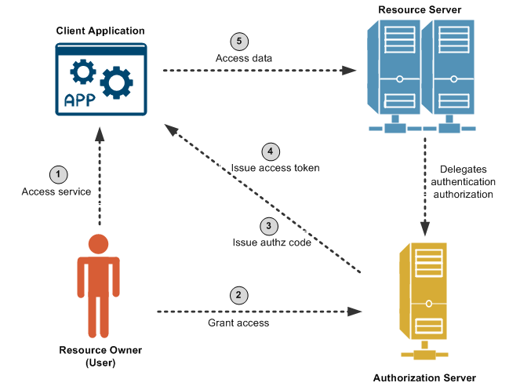
OAuth 2 Flow

Slide 12
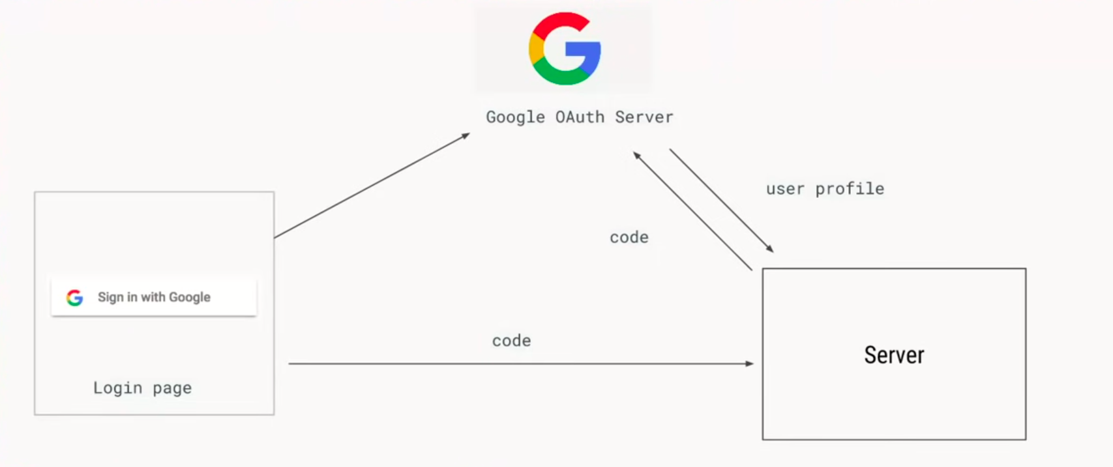
OpenID Connect Flow

Slide 13
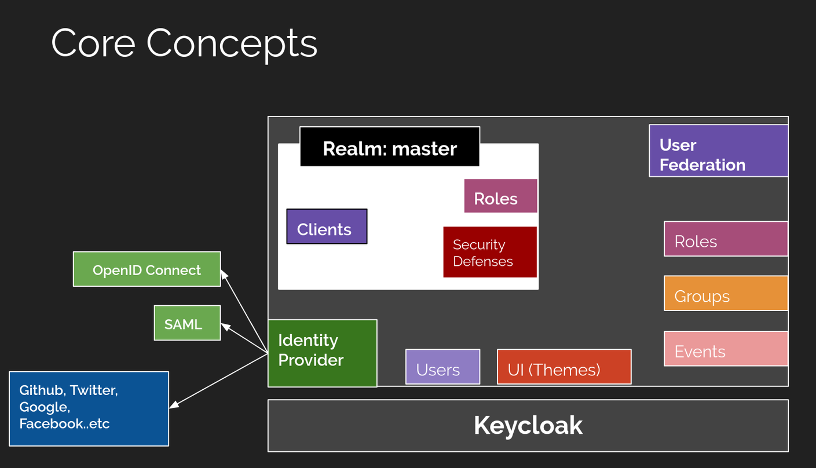
KeyCloak

Slide 14
Solution for Project
Using OpenID Connect, OAuth2.0 with Authorization Code Flow to implementing authentication, authorization, Single Sign On.
Two-factor authentication:
Username and Password
OTP via email

Slide 15
System Design

Slide 16
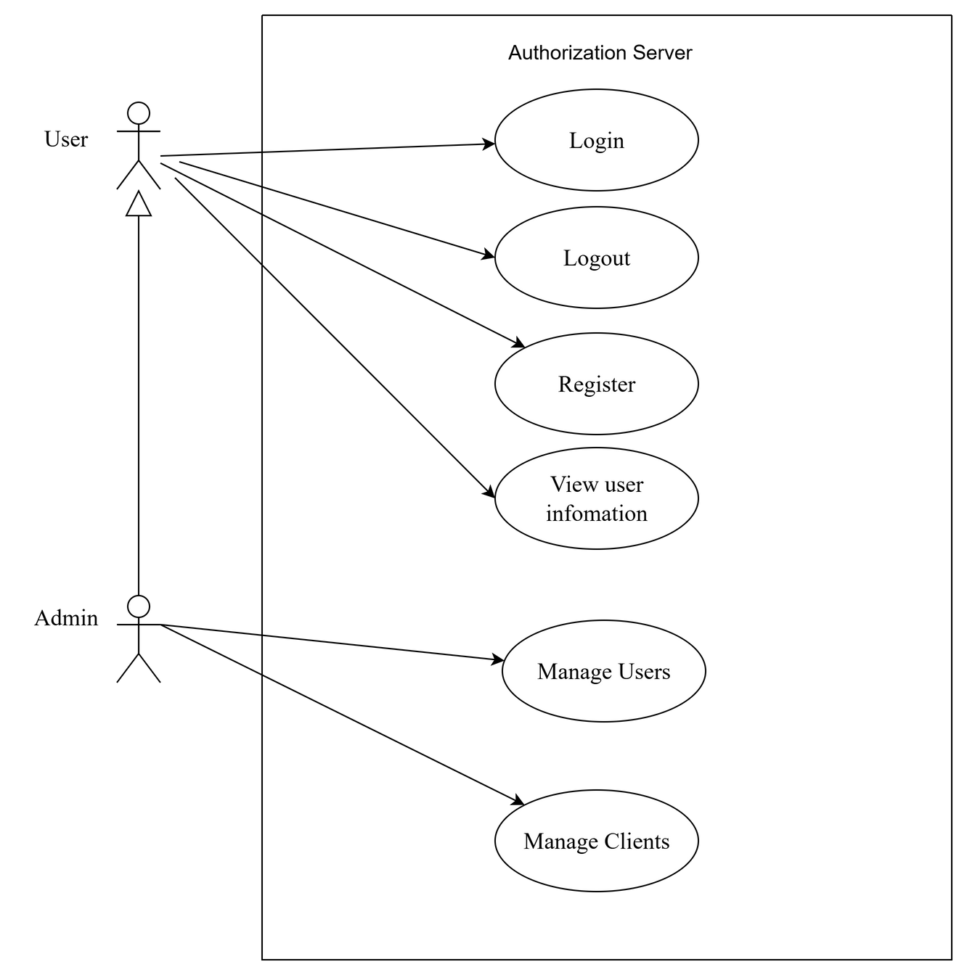
Use Case Diagram

Slide 17
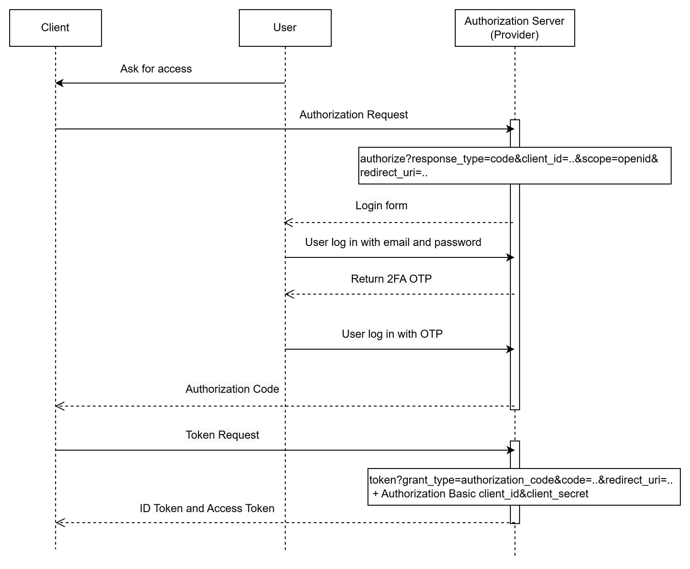
OpenID Connect authorization code flow.

Slide 18
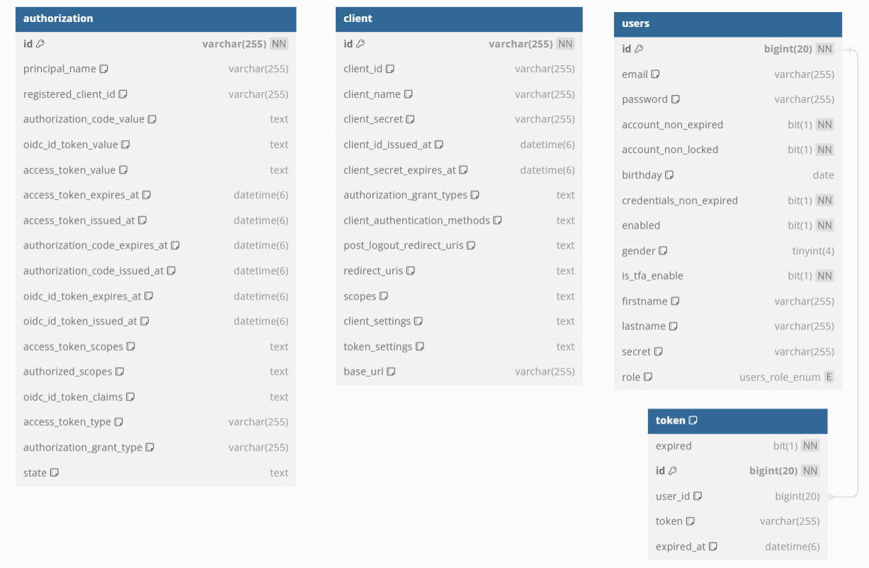
Database Design

Slide 19
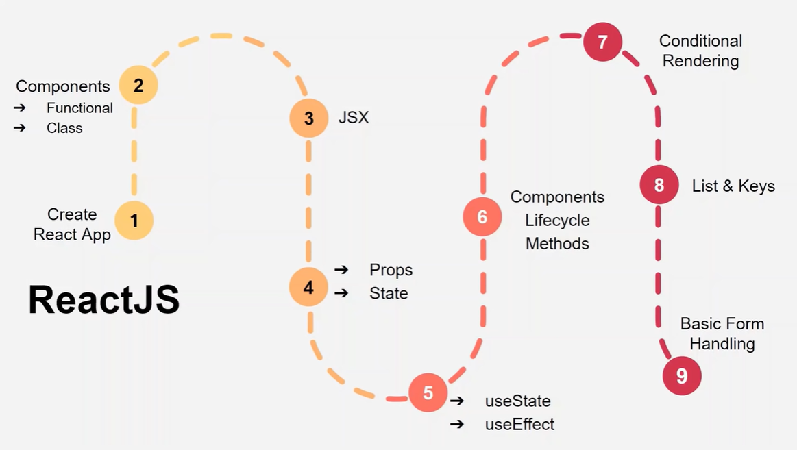
Frontend Design

Slide 20
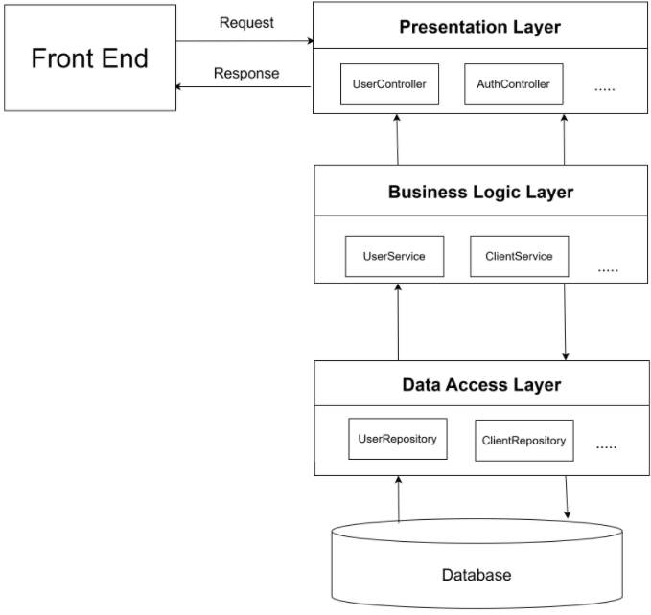
Backend Architecture
3 layer

Slide 21
Development

Slide 22


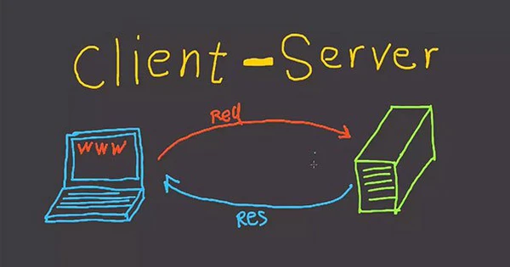
Technology
Authorization Server
FrontEnd:
ReactJS
BackEnd:
Spring Framework
Spring Authorization Server
Database:
MySQL
Demo Client
Server Side Client:
Spring OAuth2 Client

Slide 23
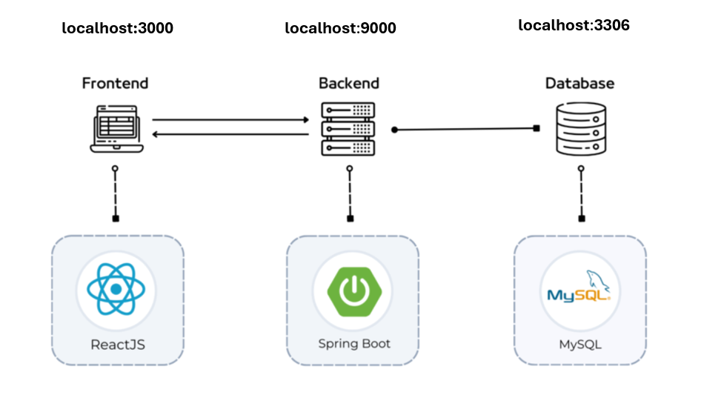
Deployment

Slide 24
Testing

Slide 25
 | Specification
Login | User Input : Username/Email Address Password Authentication : The login function shall verify the provided username/email address and password against a secure user database Success : Generate a secure session token. Store the session token on the user's client(Local storage). Redirect the user to the application's main dashboard or homepage Failure : Display error message to the user. Keep the user on the login page.
Function
Testing

Slide 26
 | Specification
Register | User input : Email Address (valid email format), Password, First name, Last name, Birthday, Gender Admin input: Email Address (valid email format), Password Hash the password using bcrypt one-way hashing algorithm Store information in a user database. Success: Display success message, redirect to login page. Failure: Display error message (invalid input, ..)
Fogot password | User Input: user's email address. Email Lookup: The function shall search the user database for an account associated with the provided email address. The system sends a verification OTP code. User input new password and OTP code to reset password. Success: Display success message, redirect to login page. Failure: Display error message, keep user on verify page.
Function
Testing

Slide 27
 | Specification
CRUD client and user | The CRUD function will cover the following operations: Create: Add new records to the database. Read: Retrieve existing records from the database. Update: Modify existing records in the database. Delete: Remove records from the database.
Logout | Invalidate the login token Delete the token from local storage Log out the user account on all clients
Function
Testing

Slide 28
Demo

Slide 29
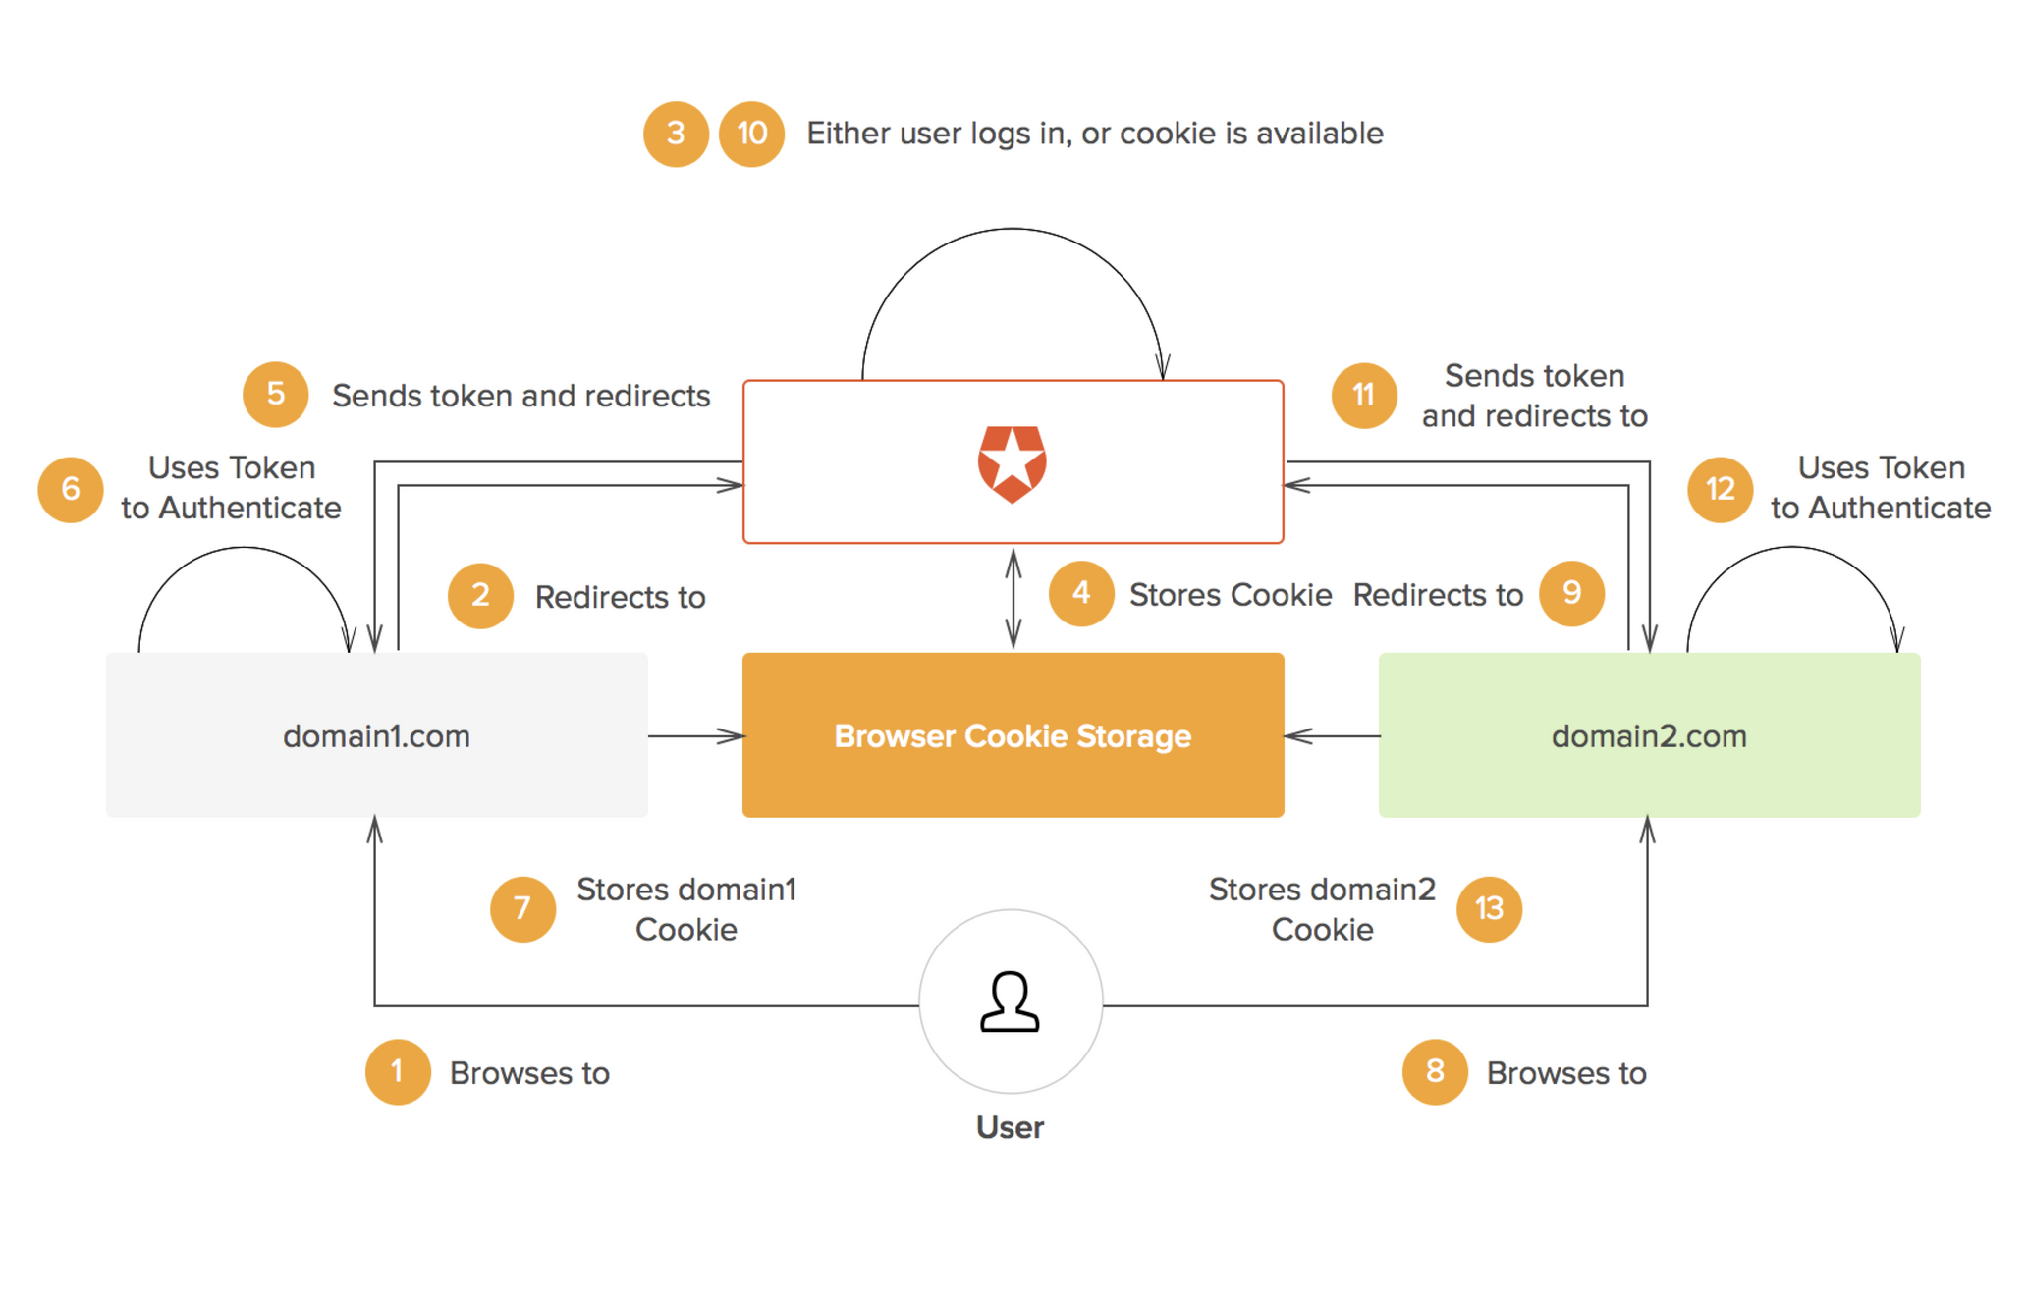
Single Sign On

Slide 30
Finish
Result
Develop user identity and access: SSO login page, support new user registration, reset password, user information page to display basic user information.
Develop a Portal for other services to register to use SSO, manage service authentication and statistic, Admin portal to configure system and service.
Provide API and workflow for other Web service integration
Support Two-factor authentication
Unfinish
Package and delivery the system in container format
Send OTP via email

Slide 31
Conclusion
System has implemented basic requirements but still has limitations that need improvement.
System can be improved by supporting more Authorization Grant Type, more authentication factor like OTP via SMS, biometric,... More type of clients can be registered to integrate with system.
Packaging the system in container format for broader deployment.

Slide 32
Thanks
Do you have any questions?

